Slide 1

Shark Attacks
José G. Portela
Edwardo S. Rivera
IronHack 2023
Data Analytics

Slide 2
Overview
Original Dataset
Hypothesis
Cleaning Techniques
Reported Incidents of Sharks
Contains data such as country, activity, type and other observations
Most shark attacks occur during surfing, with a higher frequency in the USA due to the popularity of surfing as a sport, and these attacks are unprovoked.
Renamed columns
Helper functions
Dictionaries and DF functions (apply, replace)
Filled NaN
String to lowercase
Modular Code used

Slide 3
Wrangling and Cleaning
Country
Activity
Type
fillna('') - 76
str.lower() & str.strip()
Cleaned ‘?’ with apply
Cleaned off by ones with replace
Must challenging one
Dictionary with 44 keys applied to series
Not confirmed - 610
Replaced NaN and other values with ‘Unconfirmed’ and changed not confirmed values to Unconfirmed - 67
Notes:
type after cleaning
type
unprovoked 5089
provoked 633
invalid 552
watercraft 355
sea disaster 242
unconfirmed 67
boat 7
country
usa 2535
australia 1473
south africa 597
new zealand 144
papua new guinea 136
bahamas 134
brazil 122
mexico 103
Country - fill na - 76
activity
swimming 1387
surfing 1255
fishing 1178
diving 634
not_confirmed 610

Slide 4
Exploratory Data Analysis: Pivot Tables
Hypothesis: Most shark attacks occur during surfing, with a higher frequency in the USA due to the popularity of surfing as a sport. These attacks are unprovoked.
Objectives:
1.Pivot table creation:
Understand the distribution of activities across countries in the data set
2. Hypothesis testing:
Investigate the relationship between country, type and activity.
3. Countries and Activities:
Identify the top 3 countries and activities based on overall activity counts
4. Exploration of top 3 countries
Explore the detailed types counts for the top 3 countries and activities.

Slide 5
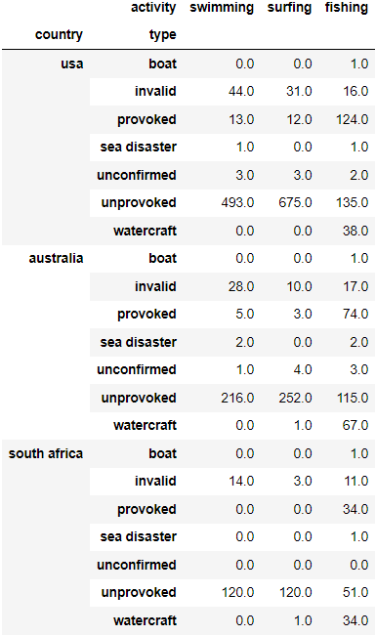
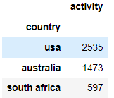
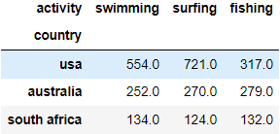
Exploratory Data Analysis:

Slide 6
Major Obstacles
Cleaning Data
Errors
Activity variable took a long time
Pivot Tables
Understanding on how to use and filter data
Merging code
Collab on github

Slide 7
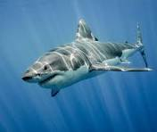
Closing Remark
In conclusion, our analysis supports the hypothesis that unprovoked shark attacks are most prevalent during surfing, especially in the USA, in line with the sport's popularity.
Notably, our insight reveals that in general, swimming has more reported incidents than surfing after thorough data cleaning. Further, fishing has more reported incidents in Australia.

Slide 8
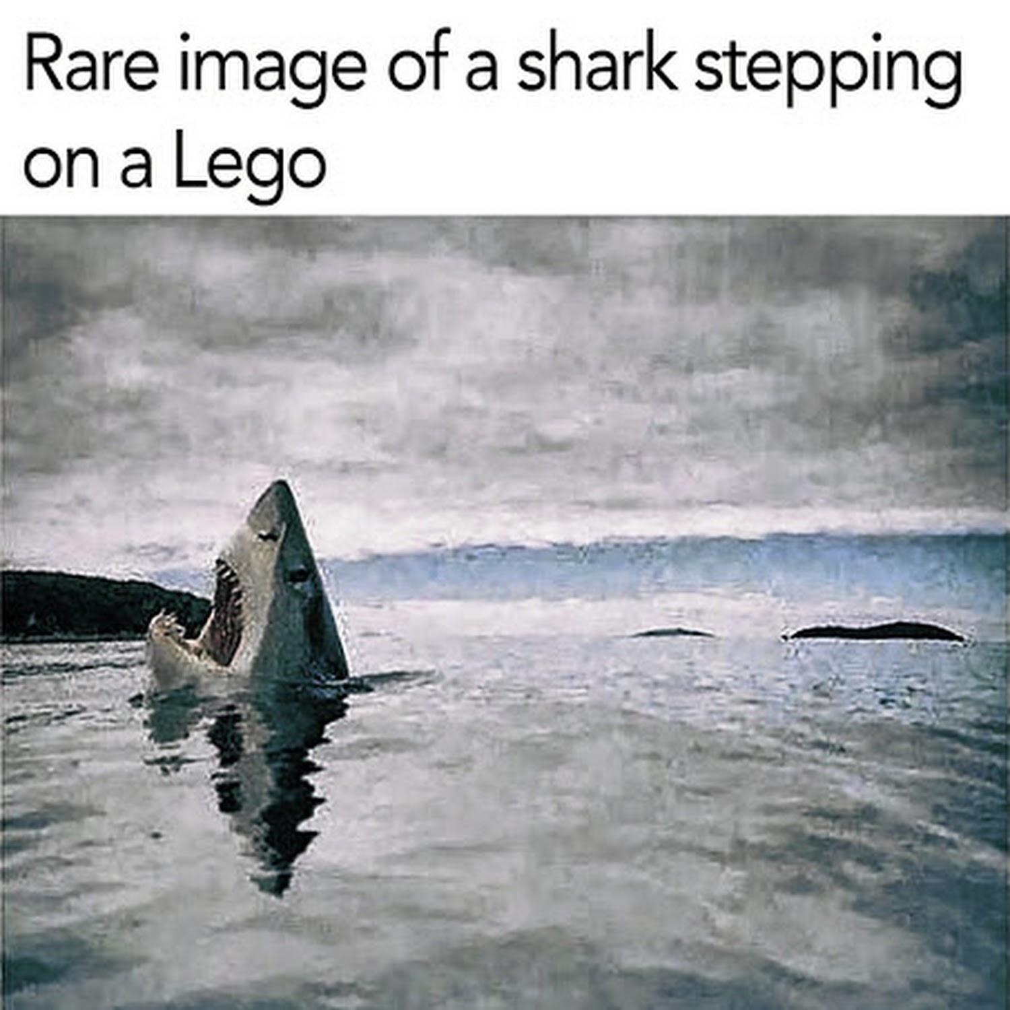
Thank you!

